Slide 1

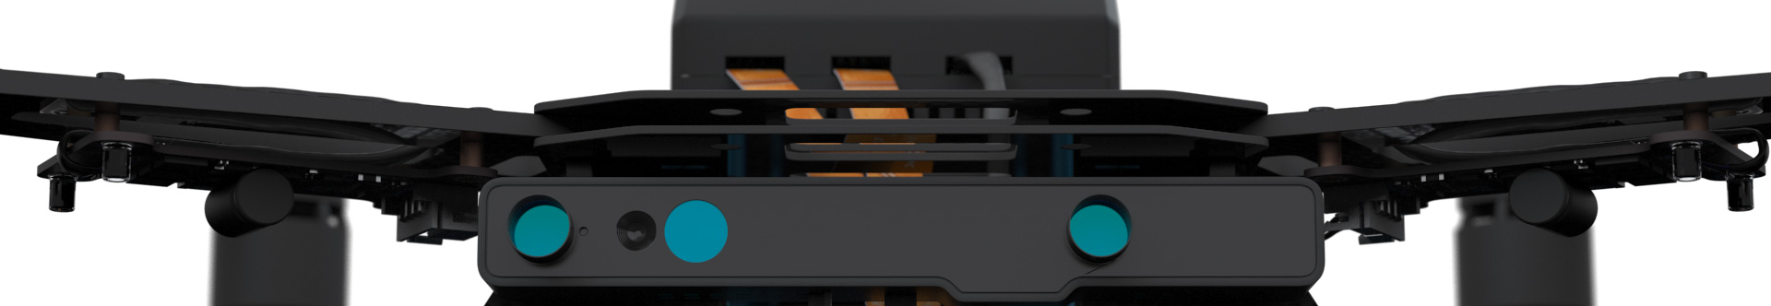
Autonomous Drone Engineer A1 – Intel Aero in 5mn
Paul.Guermonprez@intel.com Autonomous Drone Solutions Architect

Slide 2
Autonomous?
Autonomous drones are NOT an evolution of RC drones.
Everything is different:
Technical requirements
Laws and regulations
Manufacturers
Clients
Business models
It’s a disruption, not an evolution
We need specific hardware and software

Slide 3
Yet another commercial drone?
You may find several commercial drones on the market:
Nicely integrated packages
Hard to customize “black box”
Hard/impossible to resell
Lack of sovereignty
Great if you need a commercial drone with minimal customization
But manufacturers and integrators need quality ingredients to develop their product and services

Slide 4
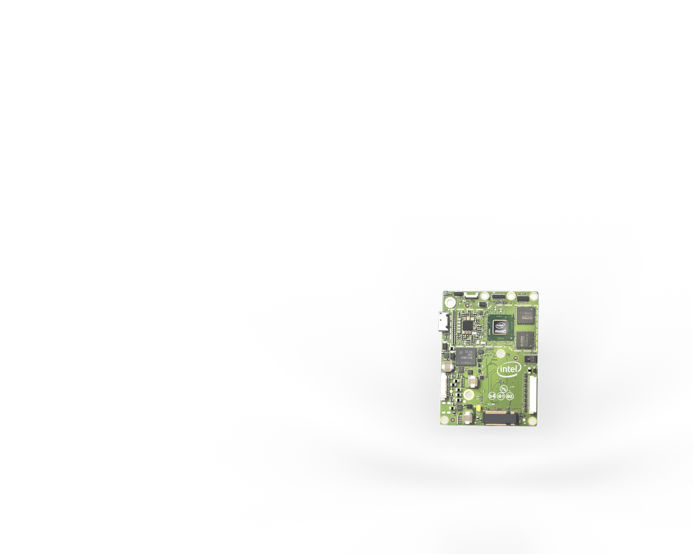
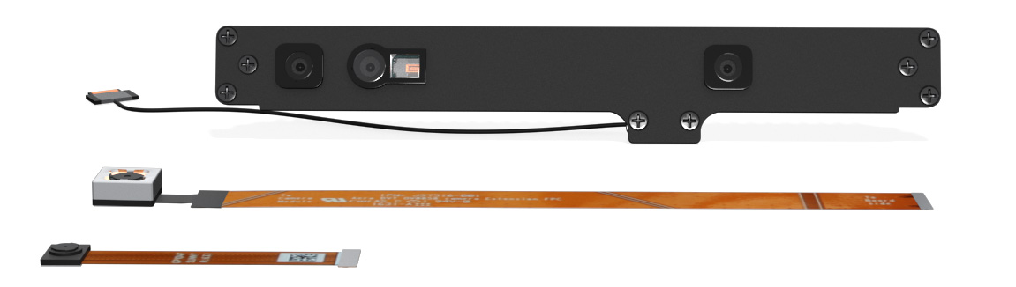
Ingredients
We propose:
Board: Intel Aero Compute Board for on board processing, storage, communications
3D Sensor: Intel RealSense for collision avoidance and SLAM
Computer Vision: Intel Movidius coming soon for advanced low power computer vision
Software: Intel SLAM library, optimized libraries and an open drone ecosystem integrate the software components of your choice
Open Course: become an Autonomous Drone Engineer in partnership with Universities worldwide
Quality ingredients, with software and courses

Slide 5
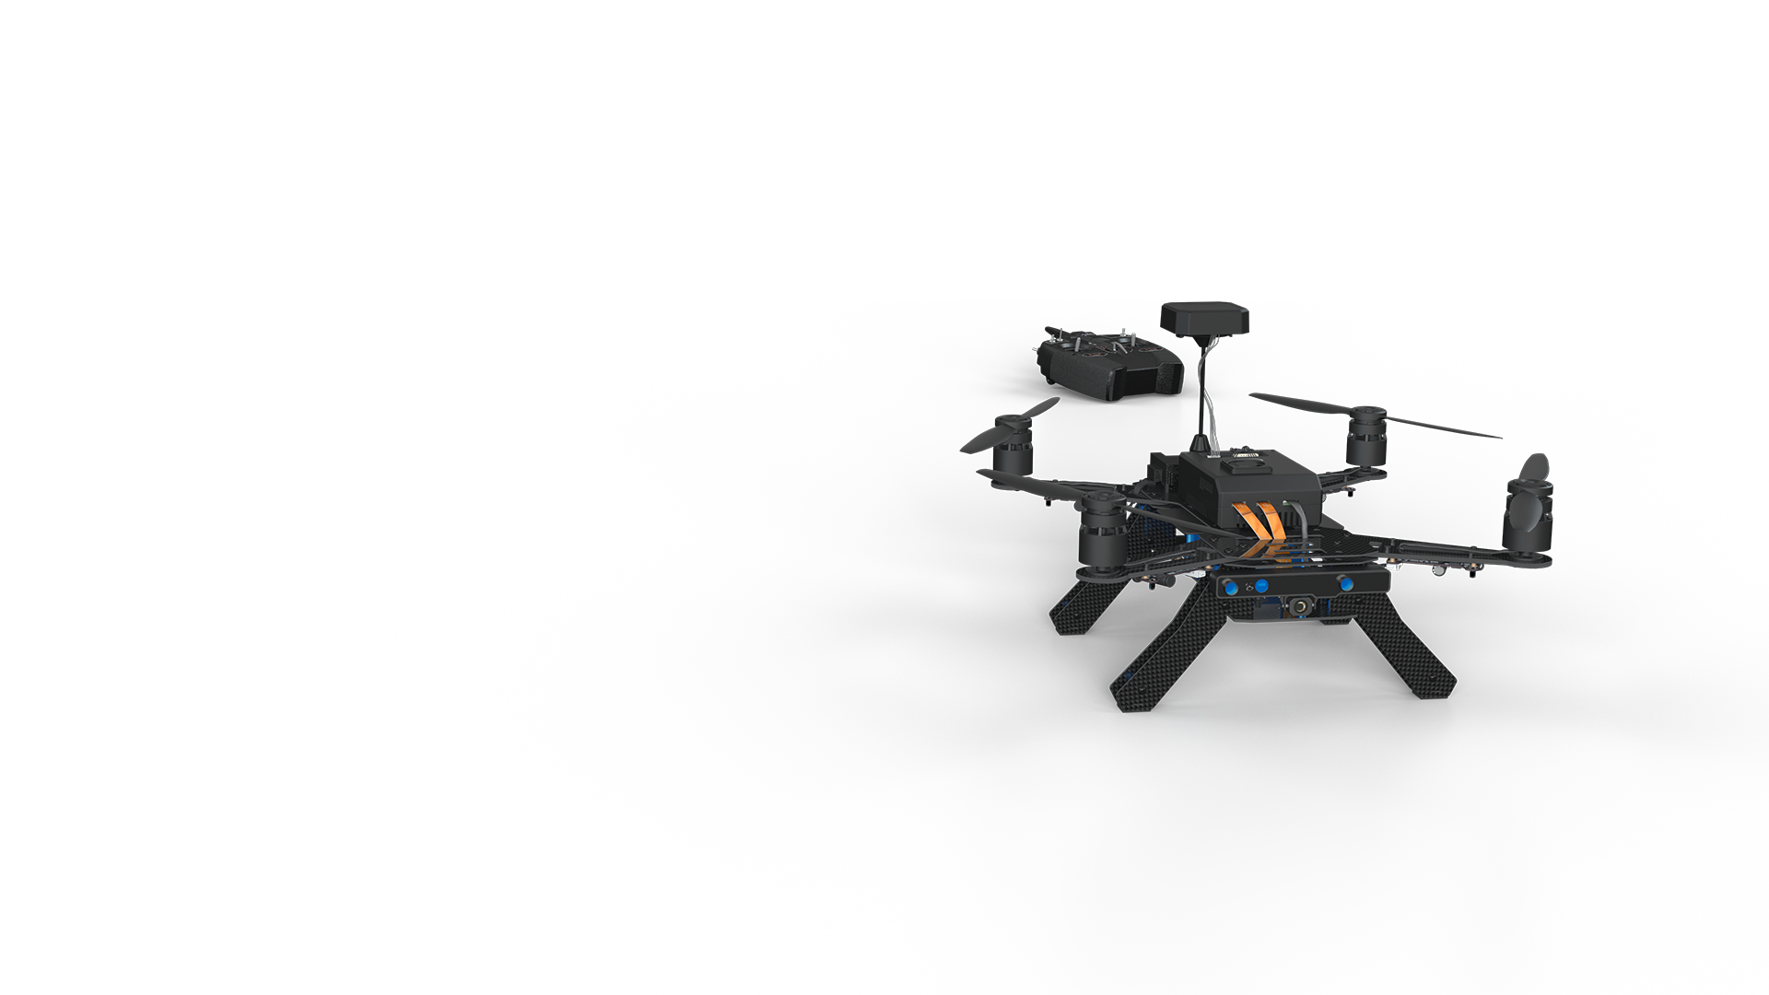
Easy prototyping: Intel Aero ReadyToFly Drone
Intel Aero’s goal is to let drone integrators build their drone but we also propose a Ready To Fly drone for fast prototyping and universities. Included:
Intel Aero Compute Board
Intel R200
Intel Aero Flight Controller and Spektrum remote
All the parts assembled: frame, motors, propellers
Reference hardware for the for the Autonomous Drone Engineer open course
Experiment and learn Autonomous Drone development with the Intel Aero RTF Drone

Slide 6
Autonomous Drone Engineer Course
As an engineer or student, use this online course to learn about autonomous drone development:
Hardware used is easily available and affordable
It’s not only about Intel Aero: we use interoperable standards and open source software as much as possible
It’s not about drones only: robotics, computer vision, artificial intelligence …
As a professor:
Use this course as a basis to build your own
Contact us, we can help you with the course customization and deployment

Slide 7
Ecosystem
You can learn and teach with the Intel Aero Ready to Fly Drone.
If you are a drone solution developer, you can go to production with the Intel Aero Compute Board and sensors.
Let us know, we are interested to learn from your product and developer experience.
If you are a client with drone needs, it may be simpler to ask a drone solution developer to develop and operate it for you.
Contact us, we can help you define your use case and find the right ecosystem partner.

Slide 8
Thanks
Paul.Guermonprez@intel.com
https://intel-aero.github.io
Released under Creative Commons-BY creativecommons.org/licenses/by/2.0/

